Slide 1
Chapter 5 B2B E-Commerce

Slide 2
LEARNING OBJECTIVES
Describe the B2B field.
Describe the major types of B2B models.
Discuss the characteristics and models of the sell-side marketplace, including auctions.
Describe the sell-side intermediaries.
Describe the characteristics of the buy-side marketplace and e-procurement.
Explain how reverse auctions work in B2B.
Describe B2B aggregation and group purchasing models.

Slide 3
LEARNING OBJECTIVES
Describe other procurement methods.
Define exchanges and describe their major types.
Describe B2B portals.
Describe third-party exchanges.
Describe how B2B can benefit from social networking and Web 2.0.
Describe Internet marketing in B2B, including organizational buyer behavior.

Slide 4
CONCEPTS, CHARACTERISTICS, AND MODELS OF B2B E-COMMERCE
business-to-business e-commerce (B2B EC)
Transactions between businesses (i.e. companies, suppliers, government) conducted electronically over the Internet, extranets, intranets, or private networks; also known as eB2B (electronic B2B) or just B2B.

Slide 5
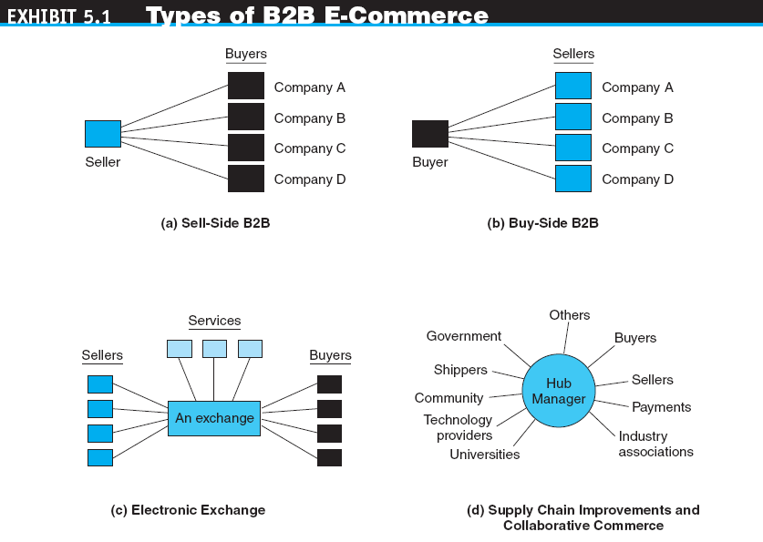

Slide 6
CONCEPTS, CHARACTERISTICS, AND MODELS OF B2B E-COMMERCE
THE BASIC TYPES OF B2B E-MARKETPLACES AND SERVICES
One-to-Many and Many-to-One: Private E-Marketplaces
company-centric EC
E-commerce that focuses on a single company’s buying needs (many-to-one or buy-side) or selling needs (one-to-many or sell-side).

Slide 7
CONCEPTS, CHARACTERISTICS, AND MODELS OF B2B E-COMMERCE
Many-to-Many: Exchanges
exchanges (trading communities or trading exchanges)
Many-to-many e-marketplaces, usually owned and run by a third party or a consortium, in which many buyers and many sellers meet electronically to trade with each other.
public e-marketplaces
Third-party exchanges open to all interested parties (sellers and buyers).
Supply Chain Improvers and Collaborative Commerce

Slide 8
CONCEPTS, CHARACTERISTICS, AND MODELS OF B2B E-COMMERCE
B2B CHARACTERISTICS
Parties to the Transaction: Sellers, Buyers, and Intermediaries
online intermediary
An online third party that brokers a transaction online between a buyer and a seller; may be virtual or click-and-mortar.

Slide 9
CONCEPTS, CHARACTERISTICS, AND MODELS OF B2B E-COMMERCE
Types of Transactions
spot buying
The purchase of goods and services as they are needed, usually at prevailing market prices.
strategic (systematic) sourcing
Purchases involving long-term contracts that usually are based on private negotiations between sellers and buyers.

Slide 10
CONCEPTS, CHARACTERISTICS, AND MODELS OF B2B E-COMMERCE
Types of Materials Traded (e.g. manufacturing)
direct materials
Materials used in the production of a product (e.g., steel in a car or paper in a book).
indirect materials
Materials used to support production (e.g., office supplies or lightbulbs).
maintenance, repair, and operation (MRO)
Indirect materials used in activities that support production.

Slide 11
CONCEPTS, CHARACTERISTICS, AND MODELS OF B2B E-COMMERCE
The Direction of the Trades
vertical marketplaces
Markets that deal with one industry or industry segment (e.g., cars, steel, chemicals).
horizontal marketplaces
Markets that concentrate on a service, material, or a product that is used in all types of industries (e.g., office supplies, PCs).
SUPPLY CHAIN RELATIONSHIPS IN B2B

Slide 12
CONCEPTS, CHARACTERISTICS, AND MODELS OF B2B E-COMMERCE
SERVICE INDUSTRIES ONLINE IN B2B
Travel and hospitality services
Real estate (e.g. government-run foreclosed property auctions are open only to corporate real estate dealers)
Financial services (e.g. SWIFT among Banks)
Online financing
Other online services (e.g. consulting, law firms)

Slide 13
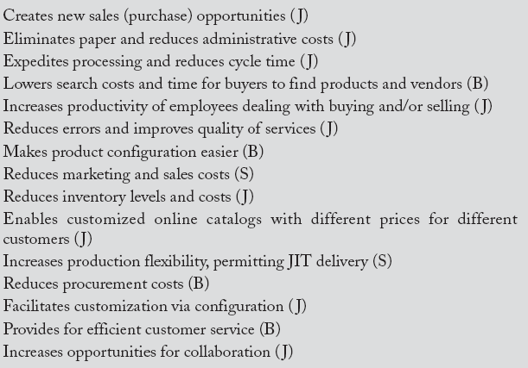
CONCEPTS, CHARACTERISTICS, AND MODELS OF B2B E-COMMERCE
THE BENEFITS OF B2B to Buyers (B), Sellers (S), or Both (J)

Slide 14
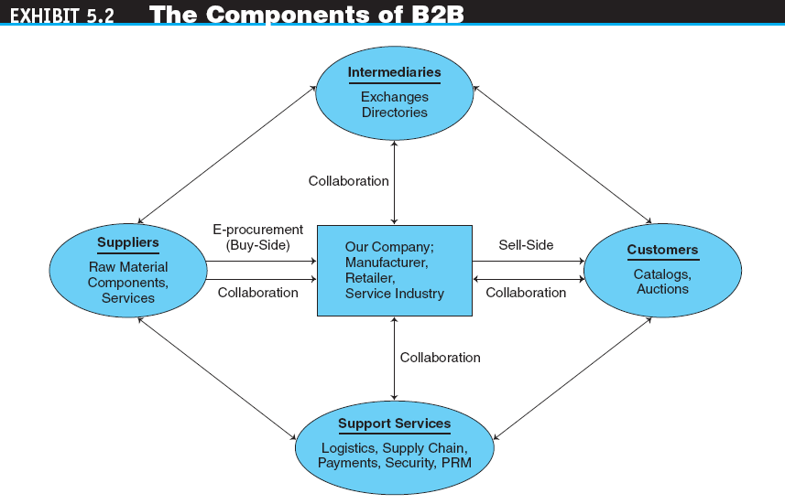

Slide 15
ONE-TO-MANY: SELL-SIDE E-MARKETPLACES
sell-side e-marketplace
A Web-based marketplace in which one company sells to many business buyers from e-catalogs or auctions, frequently over an extranet.
B2B Sellers (e.g. bigboXX.com, IBM, Cisco)
Customer Service
SELLING FROM CATALOGS (e.g. Microsoft sells to its distributors)
Configuration and Customization
Benefits (faster, more efficient, lower cost) and Limitations (how to find new buyers, channel conflicts) of Online Sales from Catalogs

Slide 16
SELLING VIA DISTRIBUTORS AND OTHER INTERMEDIARIES
Manufacturers use intermediaries to distribute their products to a large number of smaller buyers.
The intermediaries buy products from many manufacturers and aggregate them into one catalog from which they sell to customers or to retailers.
Now, many of these distributors also are selling online via Webstores.

Slide 17
SELLING VIA E-AUCTIONS
USING AUCTIONS ON THE SELL SIDE
Revenue generation (e.g. during sales promotion)
Cost savings
Increased “stickiness” (the number and length of visits by potential buyers)
Member acquisition and retention (potential new member subscriptions for future business)
AUCTIONING FROM THE COMPANY’S OWN SITE (or use third party like ebay.com)
AUCTION RULES (to prevent frauds)

Slide 18
SELLING VIA E-AUCTIONS
USING INTERMEDIARIES IN AUCTIONS
Example: Liquidation.com
EXAMPLES OF B2B FORWARD AUCTIONS (highest bids)
Sam’s Club (samsclub.com) auctions thousands of items
ResortQuest (auctionanything.com) auctions rental space for vacation rentals
At governmentauctions.org, businesses can bid on foreclosures, seized items, abandoned property, and more
Yahoo! Conducts both B2C and B2B auctions of many items

Slide 19
ONE-FROM-MANY: BUY-SIDE E-MARKETPLACES AND E-PROCUREMENT
buy-side e-marketplace
A corporate-based acquisition site that uses reverse auctions (lowest bids), negotiations, group purchasing, or any other e-procurement method.

Slide 20
ONE-FROM-MANY: BUY-SIDE E-MARKETPLACES AND E-PROCUREMENT
PROCUREMENT METHODS
E-Procurement Organization and Types
E-Sourcing (e.g. via alibaba.com)
E-Tendering
E-Reverse auctioning
E-Informing
Web-based ERP (electronic resource planning)
E-Marketsites (integrating procurement processes into suppliers’ supply chain and buyers’ financial system)
E-MRO (maintenance, repair, and operating)

Slide 21
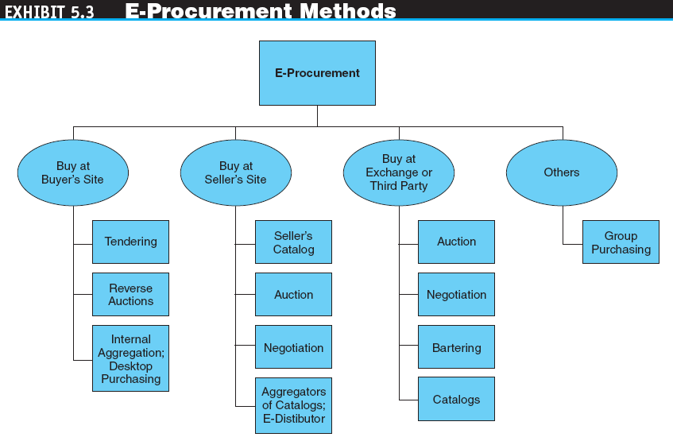

Slide 22
ONE-FROM-MANY: BUY-SIDE E-MARKETPLACES AND E-PROCUREMENT
INEFFICIENCIES IN TRADITIONAL PROCUREMENT MANAGEMENT
procurement management
The planning, organizing, and coordinating of all the activities related to purchasing goods and services needed to accomplish the organization’s mission.
maverick buying
Unplanned purchases of items needed quickly, often at non-prenegotiated higher prices.

Slide 23
ONE-FROM-MANY: BUY-SIDE E-MARKETPLACES AND E-PROCUREMENT
e-procurement
The electronic acquisition of goods and services for organizations.

Slide 24
BUY-SIDE E-MARKETPLACES: REVERSE AUCTIONS
request for quote (RFQ)
The “invitation” to participate in a tendering (bidding) system.
CONDUCTING REVERSE AUCTIONS
E-Tendering by Governments
GROUP REVERSE AUCTIONS

Slide 25
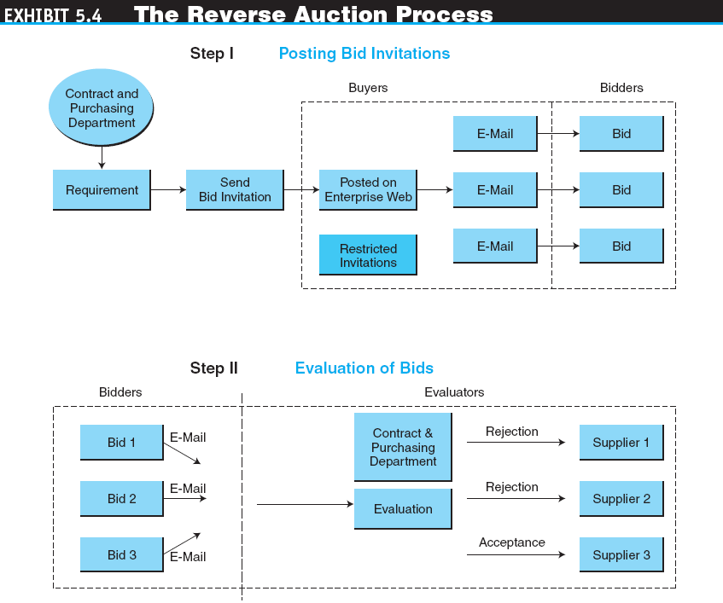

Slide 26
OTHER E-PROCUREMENT METHODS
AN INTERNAL PURCHASING MARKETPLACE: AGGREGATING SUPPLIERS’ CATALOGS AND DESKTOP PURCHASING
internal procurement marketplace
The aggregated catalogs of all approved suppliers combined into a single internal electronic catalog.

Slide 27
OTHER E-PROCUREMENT METHODS
Benefits of Internal Aggregated Catalogs
Corporate buyers can use search engines to look through internal aggregated catalogs to quickly find what they want, check availability and delivery times, and complete electronic requisition forms
The company can reduce the number of suppliers it uses

Slide 28
OTHER E-PROCUREMENT METHODS
desktop purchasing
Direct purchasing from internal marketplaces without the approval of supervisors and without the intervention of a procurement department.
BUYING AT SELLERS’ E-AUCTIONS

Slide 29
OTHER E-PROCUREMENT METHODS
group purchasing
The aggregation of orders from several buyers into volume purchases so that better prices can be negotiated.
Internal Aggregation of Purchasing Orders
External Aggregation for Group Purchasing

Slide 30
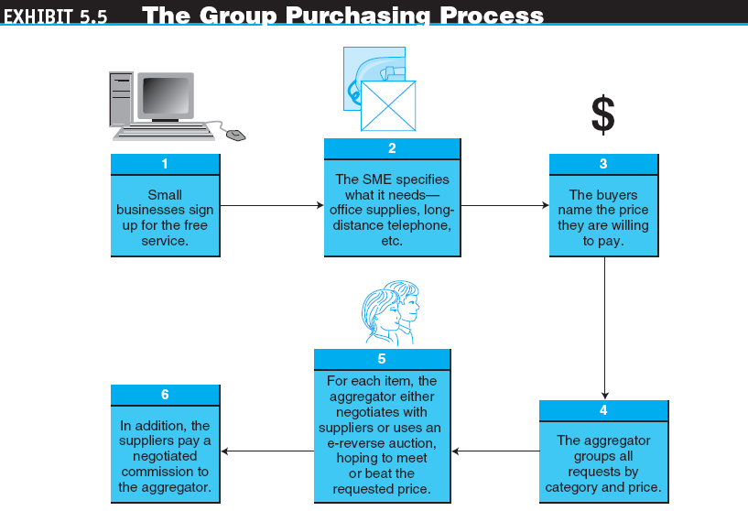

Slide 31
OTHER E-PROCUREMENT METHODS
Real Life Example for Sharing :
Group procurement of PCs with one PC company at one bank in HK
Objective : to standardise configuration and enjoy group-disccounts
Success and failure?

Slide 32
OTHER E-PROCUREMENT METHODS
BUYING AT SELLERS’ SITES AND COLLABORATIVE COMMERCE
ACQUISITION VIA ELECTRONIC BARTERING
bartering exchange
An intermediary that links parties in a barter; a company submits its surplus to the exchange and receives points of credit, which can be used to buy the items that the company needs from other exchange participants.
Copyright © 2011 Pearson Education, Inc. Publishing as Prentice Hall
5-31
Notes:
31

Slide 33
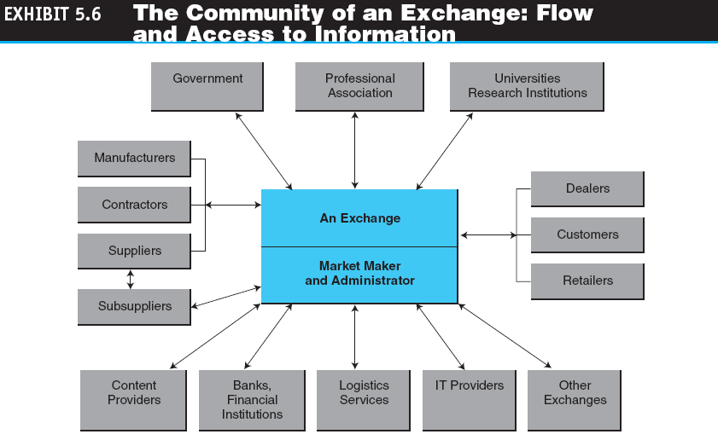

Slide 34
B2B ELECTRONIC EXCHANGES: DEFINITIONS AND CONCEPTS
FUNCTIONS OF EXCHANGES
(Many-to-many e-marketplace)
Matching buyers and sellers
Facilitating transactions
Maintaining exchange policies and infrastructure
Example: www.agentrics.com – a B2B exchange for suppliers, distributors and retail companies to do their business online and direct.

Slide 35
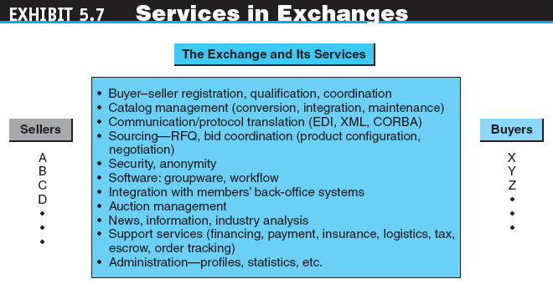

Slide 36
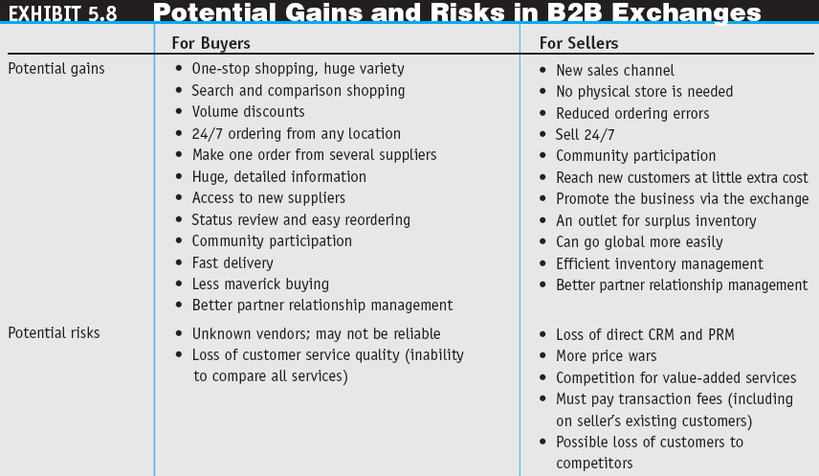

Slide 37
B2B PORTALS, DIRECTORIES, AND OWNERSHIP OF B2B MARKETPLACES
B2B portals
Information portals for businesses.
vortals
B2B portals that focus on a single industry or industry segment; “vertical portals.”
Thomas Global (a directory of over 700,000 manufacturers and distributors)
Alibaba.com Corporation
Directory Services and Search Engines

Slide 38
B2B PORTALS, DIRECTORIES, AND OWNERSHIP OF B2B MARKETPLACES
Copyright © 2011 Pearson Education, Inc. Publishing as Prentice Hall
5-37
Questions?
Is alibaba.com - information portal or exchange or both?
Vertical or horizontal ?
Notes:
37

Slide 39
B2B PORTALS, DIRECTORIES, AND OWNERSHIP OF B2B MARKETPLACES
OWNERSHIP OF B2B MARKETPLACES
Third-Party Exchanges
consortium trading exchange (CTE)
An exchange formed and operated by a group of major companies in an industry to provide industry-wide transaction services.

Slide 40
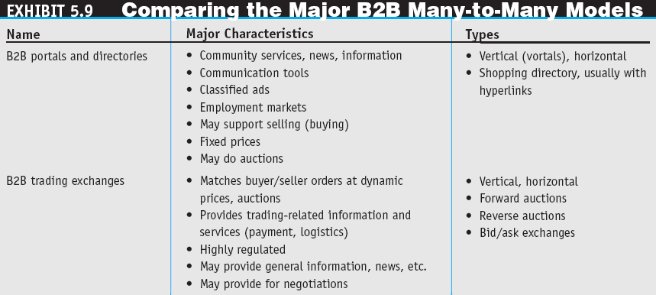

Slide 41
B2B IN THE WEB 2.0 ENVIRONMENT AND SOCIAL NETWORKING
THE OPPORTUNITIES
THE USE OF WEB 2.0 TOOLS IN B2B
SOCIAL NETWORKS IN THE B2B MARKETPLACE
EXAMPLES OF OTHER ACTIVITIES OF B2B SOCIAL NETWORKS
THE FUTURE OF B2B SOCIAL NETWORKING
Examples :
American Express Business Travel Services (BTX businesstravelconnexion.com)
Facebook, linkedin.com (for company staff)

Slide 42
INTERNET MARKETING IN B2B EC
ORGANIZATIONAL BUYER BEHAVIOR
THE MARKETING AND ADVERTISING PROCESSES IN B2B
METHODS FOR B2B ONLINE MARKETING
Targeting Customers
Electronic Wholesalers
AFFILIATE PROGRAMS, INFOMEDIARIES (bloomberg, reuters), AND DATA MINING

Slide 43
MANAGERIAL ISSUES
Which B2B model(s) should we use for e-procurement?
Which exchange to join?
What is the organizational impact of B2B?
What are some ethical issues in B2B?
How shall we manage our suppliers?
Which type of social network? Private (proprietary) or public?

